Slide 1
CYTOSKELETON
MICROTUBULES
MICRO FILAMENTS
INTERMEDIATE FILAMENTS

Slide 2
Cytoskeleton
The cytoskeleton is a complex, dynamic network of interlinking protein filaments present in the cytoplasm of all cells, including bacteria.
It extends from the cell nucleus to the cell membrane and is composed of similar proteins in the various organisms.
The cytoskeleton is a structure that helps cells to maintain their shape and internal organization, and it also provides mechanical support that enables cells to carry out essential functions like division and movement.
Multiple cellular level functions were performed by the cytoskeleton which includes,
self-propulsion, cleavage, morphogenesis, exocytosis, endocytosis, intracellular transport and changing the cell shape.

Slide 3
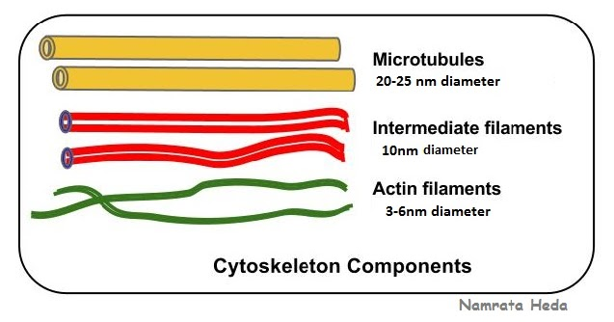
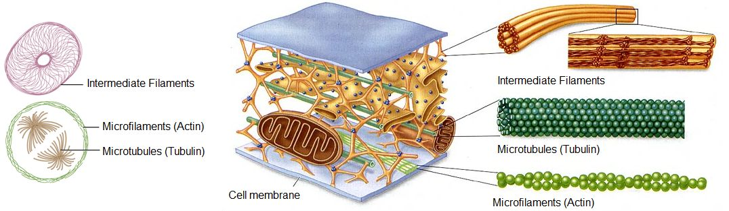
components of cytoskeleton

Slide 4
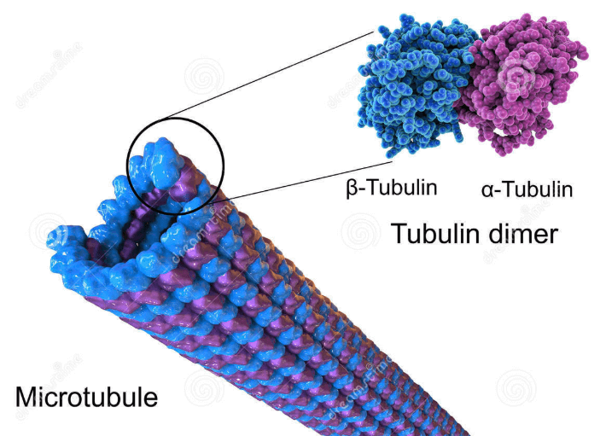
Microtubules
Microtubules are polymers of tubulin that form part of the cytoskeleton and provide structure and shape to eukaryotic cells.
Microtubules can grow as long as 50 micrometres and are highly dynamic.
The outer diameter of a microtubule is between 23 and 27 nm while the inner diameter is between 11 and 15 nm.
They are formed by the polymerization of a dimer of two globular proteins.
The most common form of a microtubule consists of 13 protofilaments in the tubular arrangement.

Slide 5
FUNCTIONS
Microtubules are very important in a number of cellular processes.
They are involved in maintaining the structure of the cell and, together with microfilaments and intermediate filaments, they form the cytoskeleton.
They also make up the internal structure of cilia and flagella.
They provide platforms for intracellular transport and are involved in a variety of cellular processes, including the movement of secretory vesicles, organelles, and intracellular macromolecular assemblies.
They are also involved in cell division (by mitosis and meiosis) and are the major constituents of mitotic spindles, which are used to pull eukaryotic chromosomes apart.

Slide 6
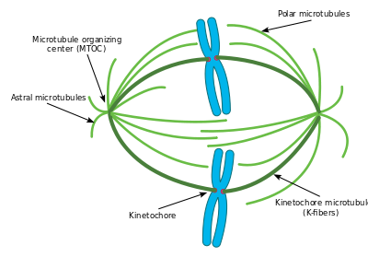
This diagram depicts the organization of a typical mitotic spindle found in animal cells. Shown here are the three main types of microtubules during mitosis and how they are oriented in the cell and the mitotic spindle.

Slide 7
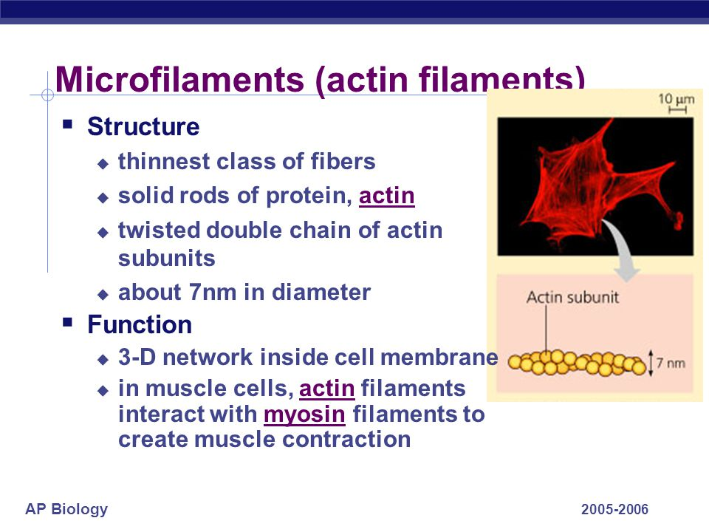
Micro filaments/Actin filaments

Slide 8
Intermediate filaments
Intermediate filaments have a diameter of about 10 nm, which is intermediate between the diameters of the two other principal elements of the cytoskeleton, actin filaments (about 7 nm) and microtubules (about 25 nm).
Intermediate filaments are a family of structures with dimensions (diameter 8 to 10 nm) intermediate between actin filaments and microtubules.
Several different types of monomeric protein subunits reversibly form intermediate filaments.
One function of intermediate filaments is to provide internal mechanical support for the
cell and to position its organelles.
The intermediate filaments composed of keratins, a family of structural proteins Hair, fingernails, and feathers are among the structures composed primarily of keratins.

Slide 9
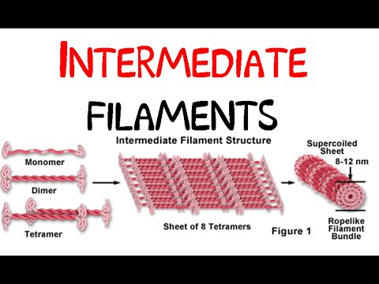
Functions
The function of intermediate filaments is largely mechanical, meaning they provide support for the cell so that other microfilaments can more readily do their transport jobs.
Some intermediate filaments are even arranged in a mesh-like pattern to provide for the different support needs of different kinds of cells.

Slide 10
MOTOR PROTEINS
Motor proteins are a class of molecular motors that can move along the cytoplasm of animal cells.
They convert chemical energy into mechanical work by the hydrolysis of ATP. Motor proteins convert chemical energy into motion.
The proteins such as myosin, kinesin, and dynein, that can move along a filament or polymeric molecule using energy generated by the hydrolysis of ATP .

Slide 11
Actin and Myosin motors
The total mass of a muscle is made up of 75% of water and 20% or above the protein molecules.
In that two major proteins are actin and myosin.
Actin filaments were bind to a family of a protein molecule called myosins, molecular motors that convert the chemical (potential) energy of ATP into mechanical (kinetic) energy, moving along the actin filaments.

Slide 12
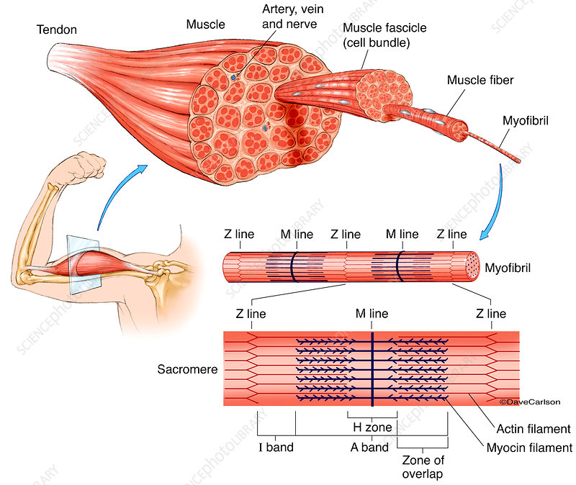

Slide 13
Mechanism of Actin and Myosin
The major biochemical reactions occurring during one cycle of muscle contraction and relaxation can be described in the five-step processes.
Step 1: Relaxation phase. In this phase of muscle contraction, the head of the myosin
hydrolyzes ATP to ADP and P i , but these products remain bound.
Step 2: Contraction phase. When the contraction of the muscle is stimulated by Ca2 + , troponin, tropomyosin, and actin are plays a central role in the regulation of muscle contraction. In that actin becomes accessible and the head of the myosin binds and forms actin-myosin-ADP-P i complex indicated.
Step 3: Power Stroke. This is followed by the release of ADP and is associated by a large conformational change in the head of myosin in pulling actin nearly about 10 nm toward the center of the sarcomere. This is known as the power stroke. The myosin is now low-energy state.
Step-4: Complex formation. One more molecule of ATP binds to the globular head of myosin, forming an actin-myosin-ATP complex.
Step 5: Released phase. The complex of myosin-ATP has a low affinity for actin, and actin is thus released.
Next cycle then starts with the hydrolysis of ATP, which reforming the high energy conformation.

Slide 14
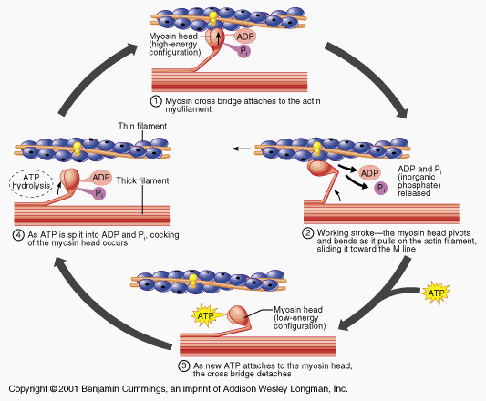
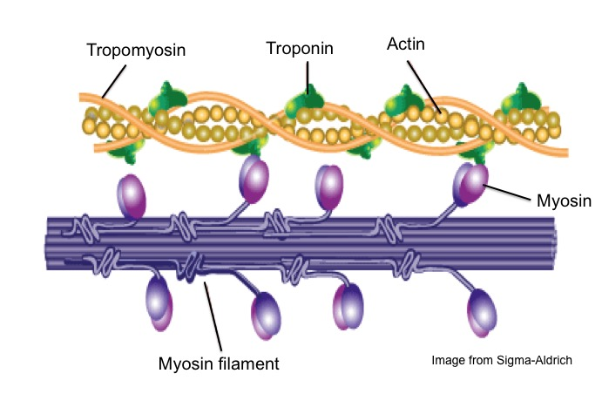
Muscle contraction mainly consists of the cyclic attachment. The head binds and moves along an actin filament, driven by the breakdown of ATP.

Slide 15
Dynein and kinesin motor proteins
Dynein is a family of cytoskeletal motor proteins that move along microtubules in cells.
They convert the chemical energy stored in ATP to mechanical work. Dynein is a complex protein is composed of six different polypeptides, those are present in two forms single dynein heavy chain (DHC) and and the three dynein light chain (DLC)..
Dynein transports various cellular cargos, provides forces and displacements important in mitosis, and drives the beat of eukaryotic cilia and flagella.
A kinesin is a protein belonging to a class of motor proteins found in eukaryotic cells.
kinesin is a heterotetrameric protein (Hetero = Head+Tail, Tetrameric (4) = two heavy chains and two light chains)
Kinesins move along microtubule (MT) filaments, and are powered by the hydrolysis of adenosine triphosphate (ATP) (thus kinesins are ATPases), a type of enzyme.

Slide 16
